Slide 1
Estimating the Conditional CAPM with Overlapping Data Inference
March 22, 2013
Esben Hedegaard and Bob Hodrick
Arizona State Univ. Columbia and
NBER

Slide 2
Goals of the Project
Demonstrate how to estimate explicitly conditional asset pricing models with overlapping data inference (ODIN).
Apply the methodology to the prediction of the conditional CAPM – the expected return on the market is a linear function of the conditional variance of the market.
Use the conditional CAPM as a laboratory to explore reductions in standard errors and improvements in power with simulations.
Compare MIDAS to GARCH in U.S. data.

Slide 3
Why We Need ODIN
Economic models are often developed in continuous time abstracting from financial frictions.
Econometric analysis of the models must choose a horizon – Merton (1980) proposed a one-month horizon as “not an unreasonable choice.”
Explicit analysis of conditional asset pricing models is usually done with maximum likelihood with the data sampled at the same frequency as the horizon of the model.
Using all of the daily data increases the effective sample size.

Slide 4
The Results
The methodological contribution is to use the first order conditions of MLE as orthogonality conditions in GMM.
MIDAS is quite similar to GARCH – Ghysels, Santa Clara, and Valkanov (2005) is wrong.
Lundblad (2007) overstated the difficulty of rejecting the null when it is false, but not by much.
Using ODIN reduces standard errors by as much as an additional 30 years of monthly data for a 1,000 month sample.
It is important to include a constant in the conditional means to test the conditional prediction of the model.
ODIN constrains the various individual non-overlapping estimates to be the same. There is considerable variety in the unconstrained.

Slide 5
The Conditional CAPM
Estimate the conditional variance with GARCH or MIDAS

Slide 6
An Alternative MIDAS Specification

Slide 7
The ODIN Model
where t_{m} indexes monthly data
where t indexes daily data

Slide 8
The Methodology
We take the first order conditions of the daily model recognizing that the errors are serially correlated.
We use these FOCs as orthogonality conditions of GMM.
We use Hansen’s asymptotic distribution theory to generate standard errors that allow for the overlapping errors.

Slide 9
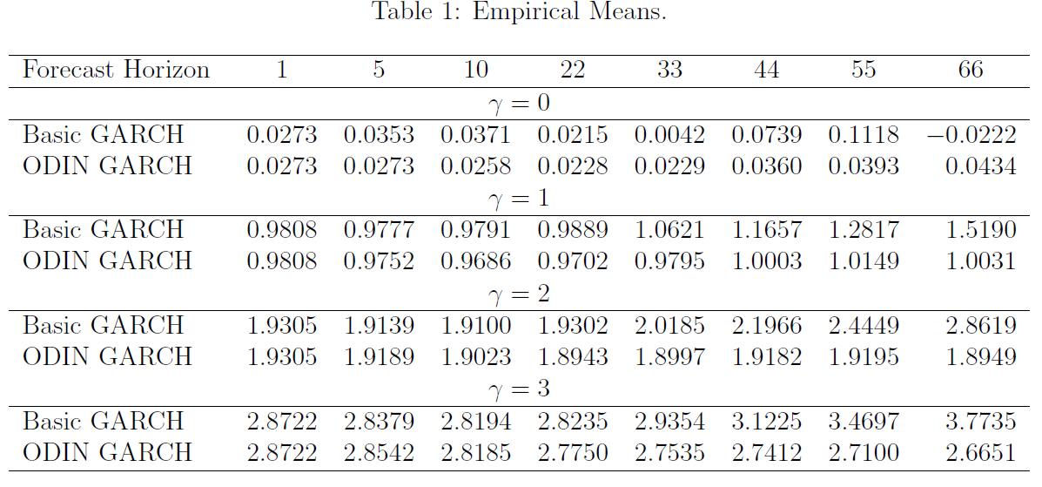
Simulation Results for the Risk-Return Trade-Off

Slide 10
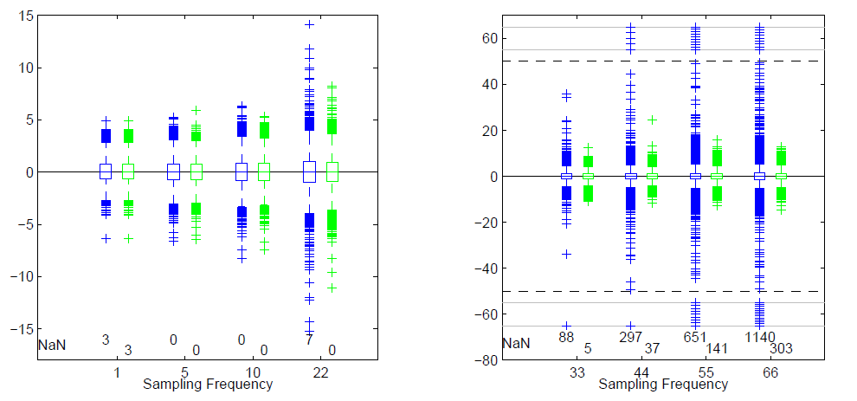
Box Plots of the Distributions

Slide 11
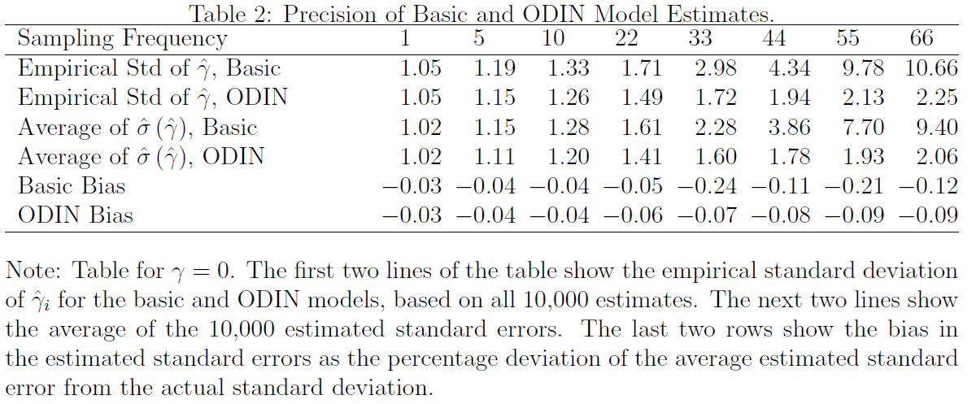
Standard Errors

Slide 12
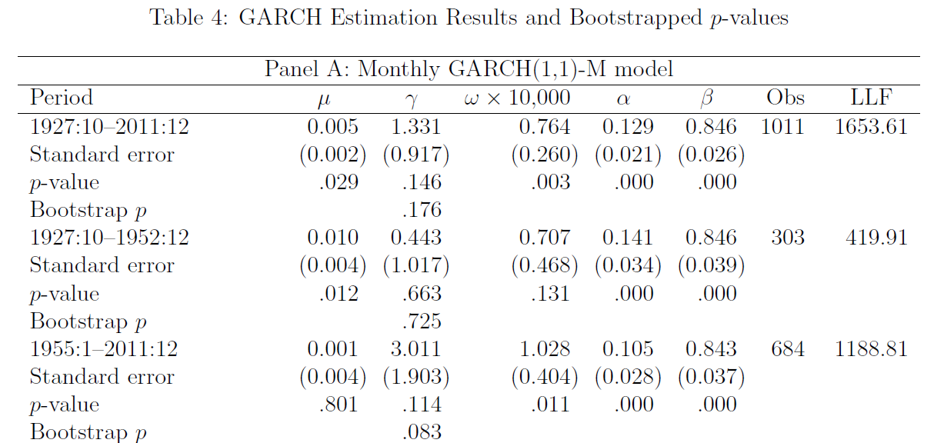

Slide 13
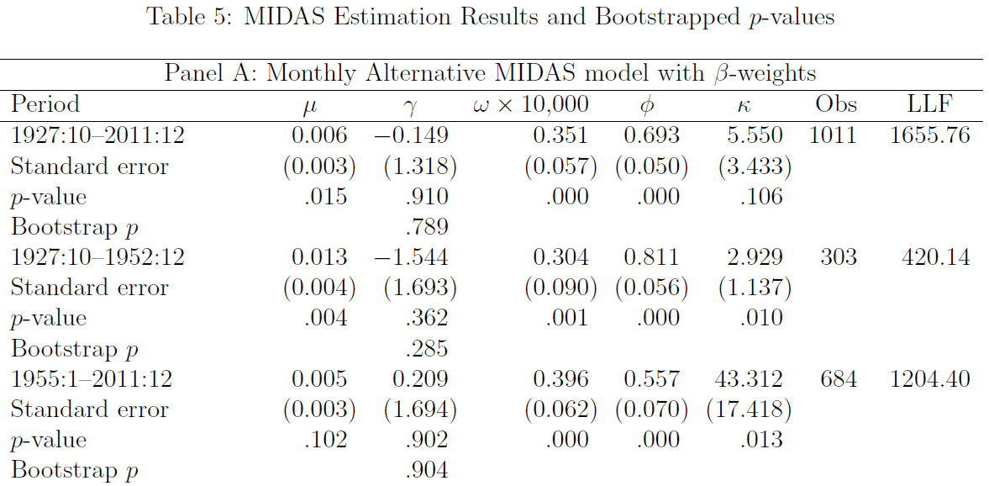

Slide 14
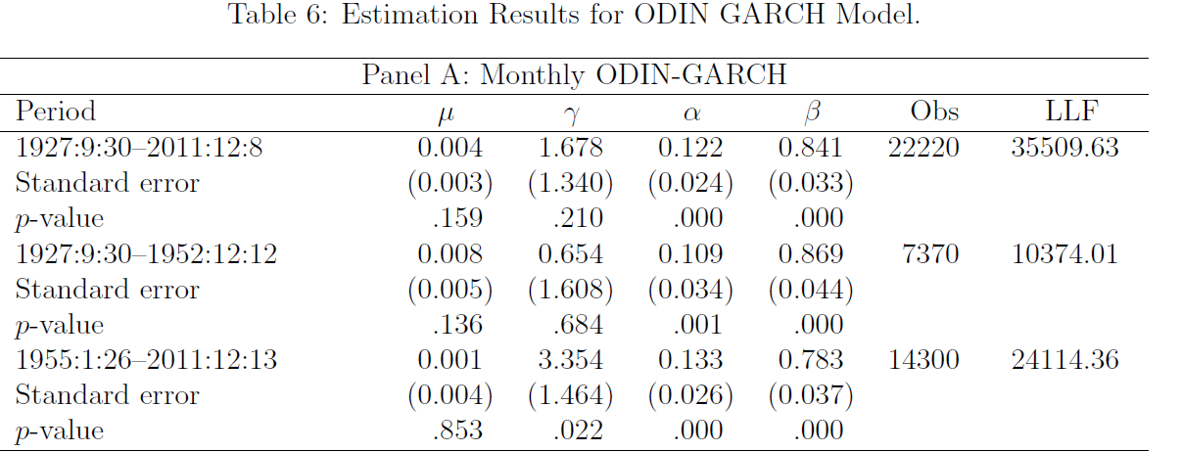

Slide 15
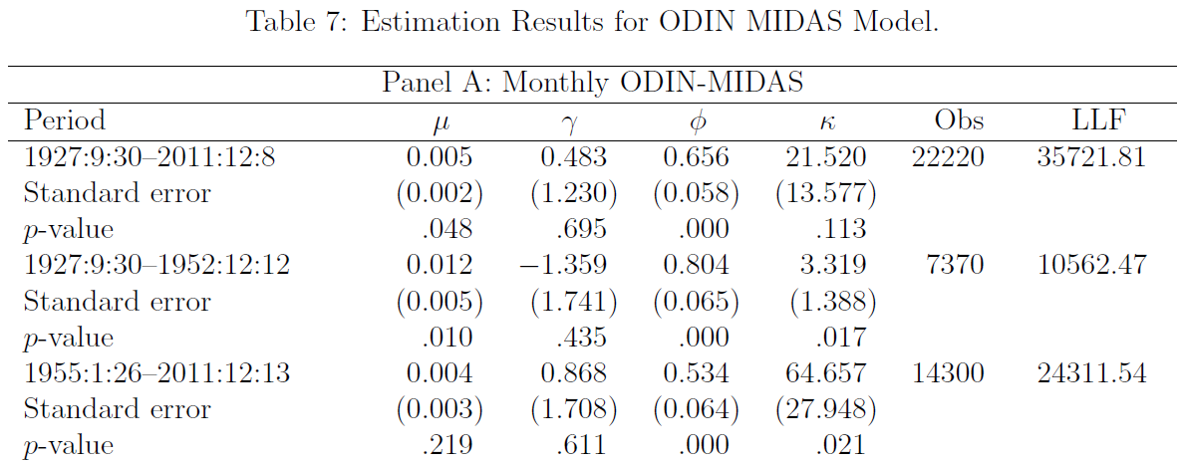

Slide 16
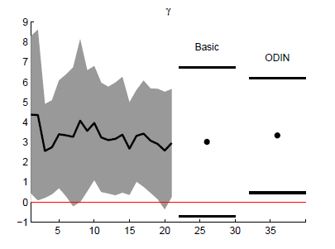
Individual Estimates Compared to Basic and ODIN

Slide 17
Conclusions
ODIN allows estimation using all the data, reduces standard errors when the null is true, and forces one to think about the different possible starting dates.
The starting date matters, and there is substantial volatility in the individual parameter estimates.
The average of the individual estimates is an estimator. Its standard error is the same asymptotically as ODIN’s s.e.
The Conditional CAPM is probably too simple. We need multiple risk factors.

